Slide 1
Data and experimental details
Notes
We performed measurements on bare sensor and sensor with film on three processing conditions with low, medium and high mass uptakes
Sensor one is sample ID 81, sensor two is sample ID 21, sensor 3 is sample ID 53 in the table Jake shared a while back
4 overtones (3, 7, 9, and 13), data acquisition rate ~20 Hz
In the zip files there are separate excel files for the sensor and the film, and there is a stitched for all measurements done on the same sensor
The solvent blend and thin film annealing temperature are in the file names
In the excel files there are:
Raw data
Data correction
Delta F (air and solvent baseline) and delta m (delta m is not included in the stitched data)
Delta D (air and solvent baseline)
Experimental process
Air: measure ~ 6 min
n-butyl acetate (nBA): 150 uL of nBA dripped to the center of the sensor, measure for ~ 6 min
F4TCNQ: 100 uL of 5 mg/mL (F4TCNQ/nBA) solution dripped to the center of the sensor to achieve 2 mg/mL concentration, measure for ~ 6 min
Plots of exemplar data included in the next slide

Slide 2
Sample information
Sample | Conductivity after doping (S/cm) | Thickness before doping (nm) | Thickness after doping (nm) | Uptake old (ng/cm²) | Uptake New (ng/cm²)
Sensor one ID 81 | 49.87 | 265.25 | 437 | 1300 | 924
Sensor two ID 21 | 20.94 | 237 | 415 | 411 | 501
Sensor three ID 53 | 15.31 | 234.5 | 754 | 645 | 655
The mass change in the Uptake New column is calculated from this new data set everything else are from the data Jake shared a while back
I did not include the paracrystallinity and coherence length here, but they are in the data Jake shared
This QCM-D data is collected on a different batch of polymer, so the thickness before/after doping might be different from what’s in the old data set. We will follow up with the new thickness data later

Slide 3
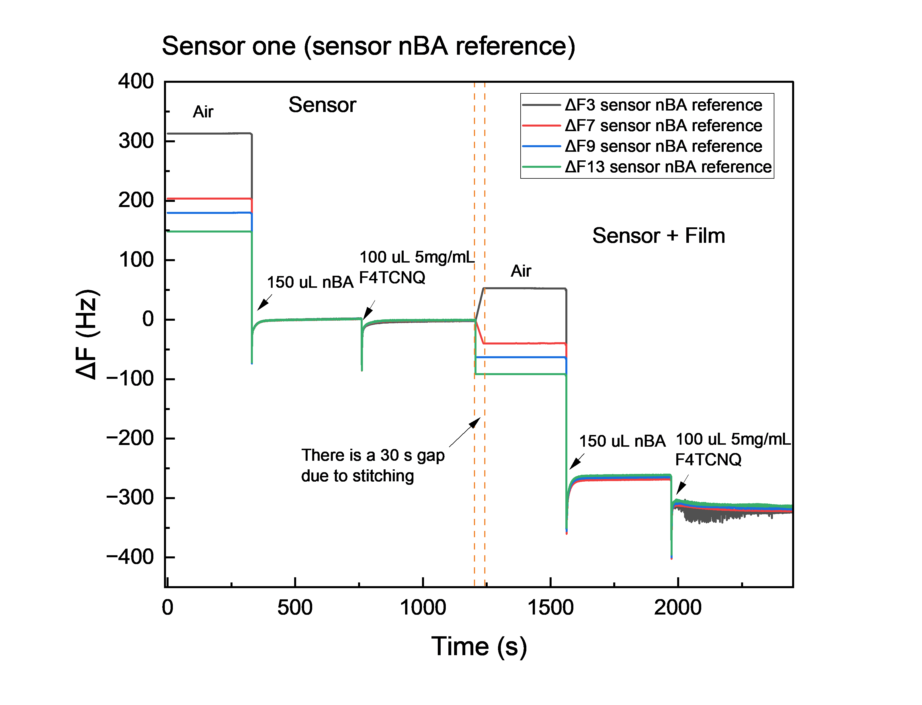
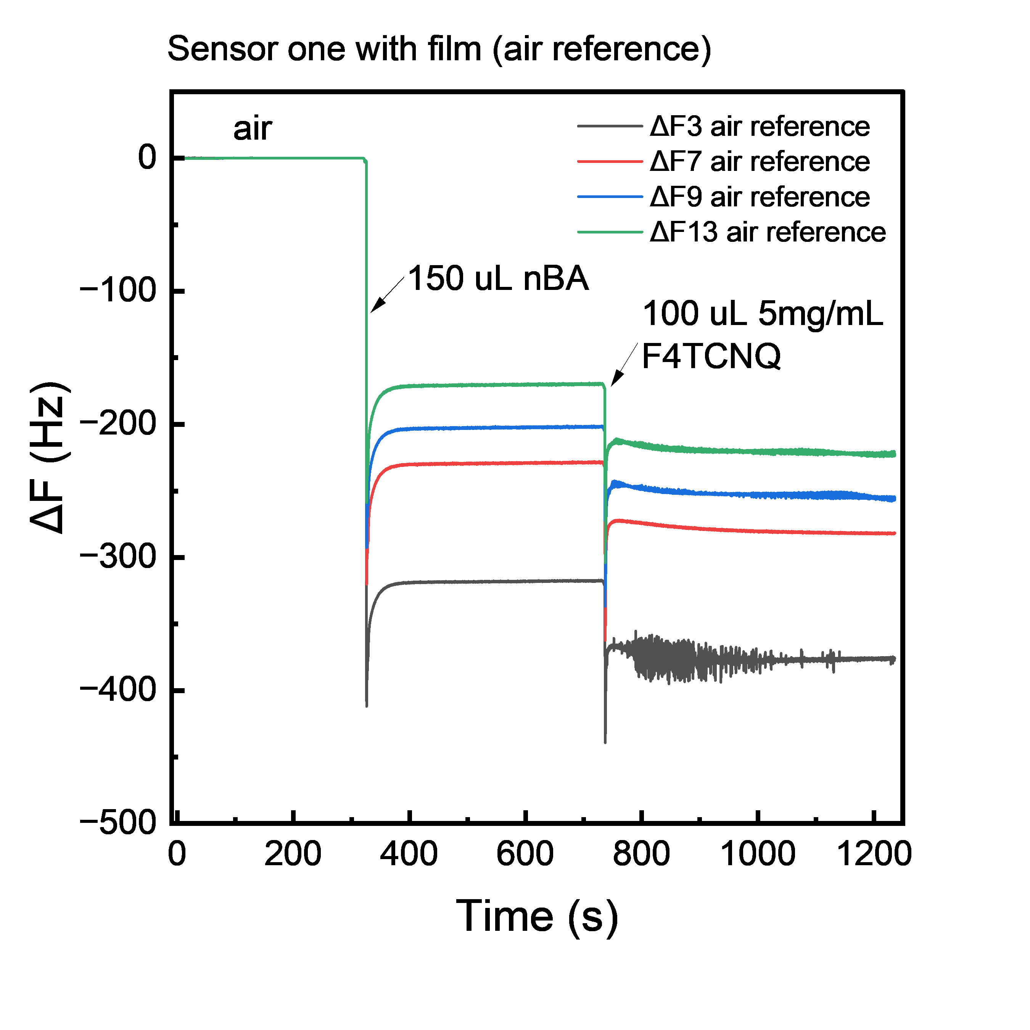
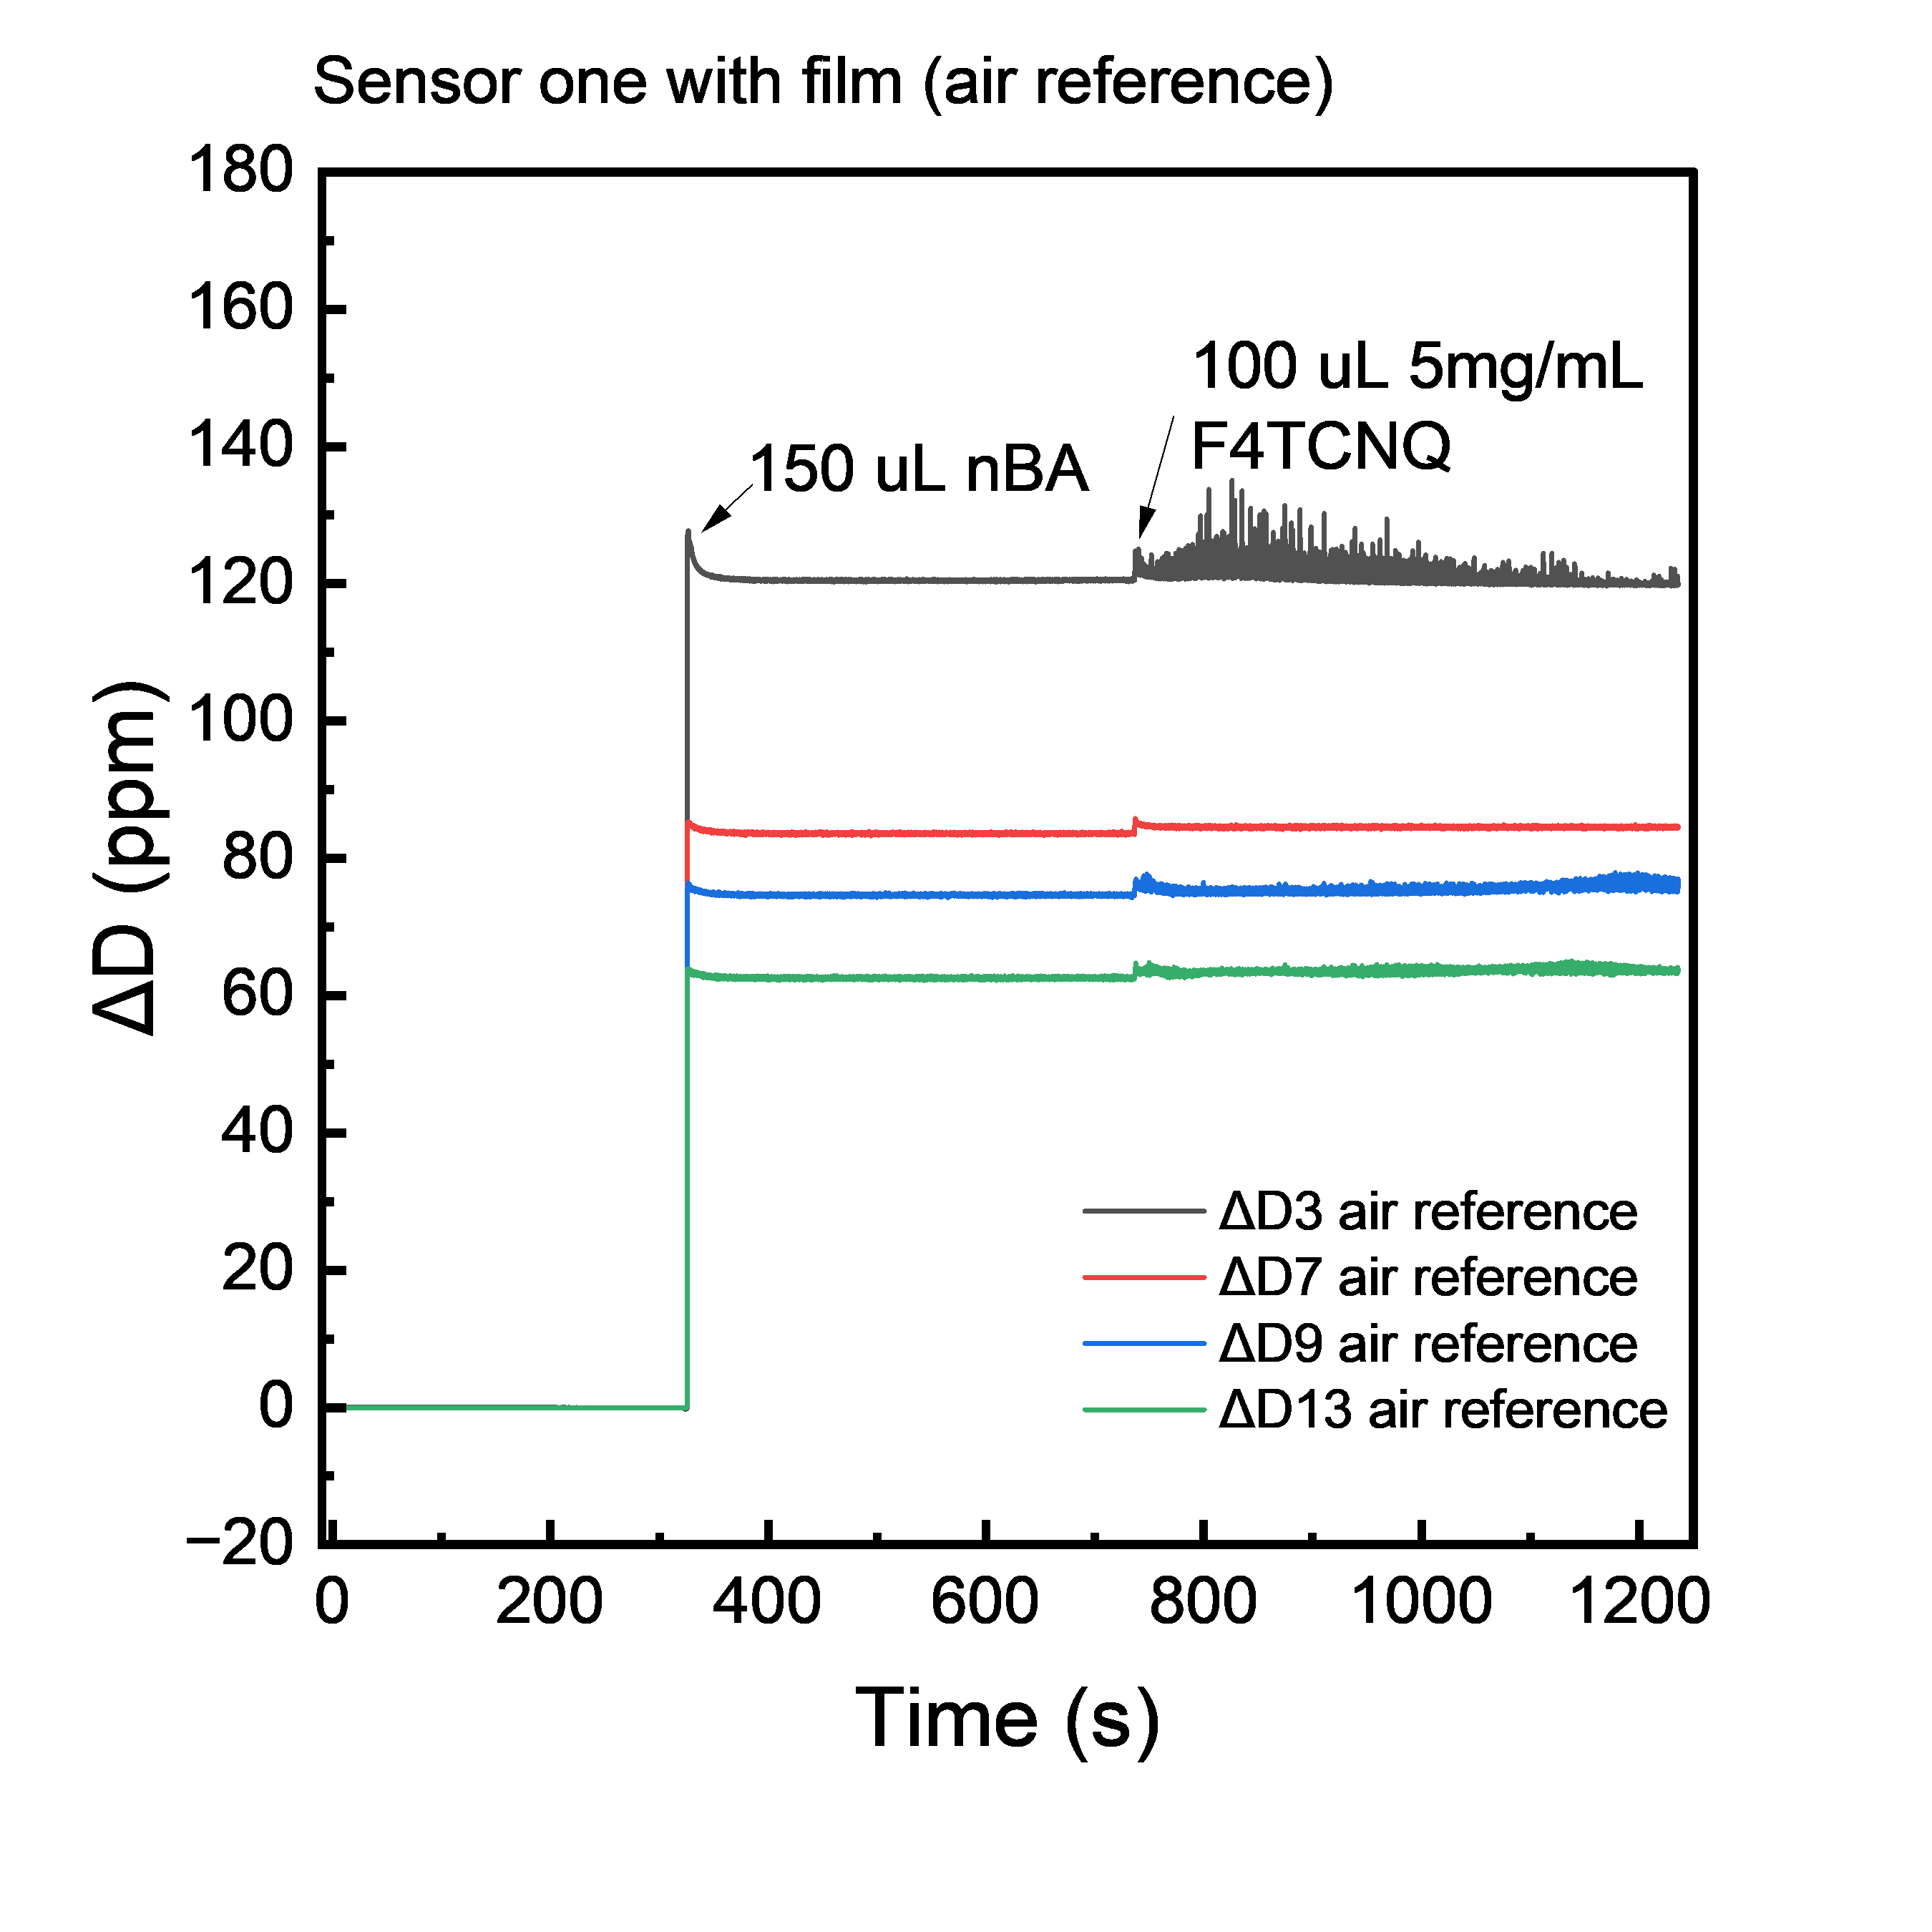
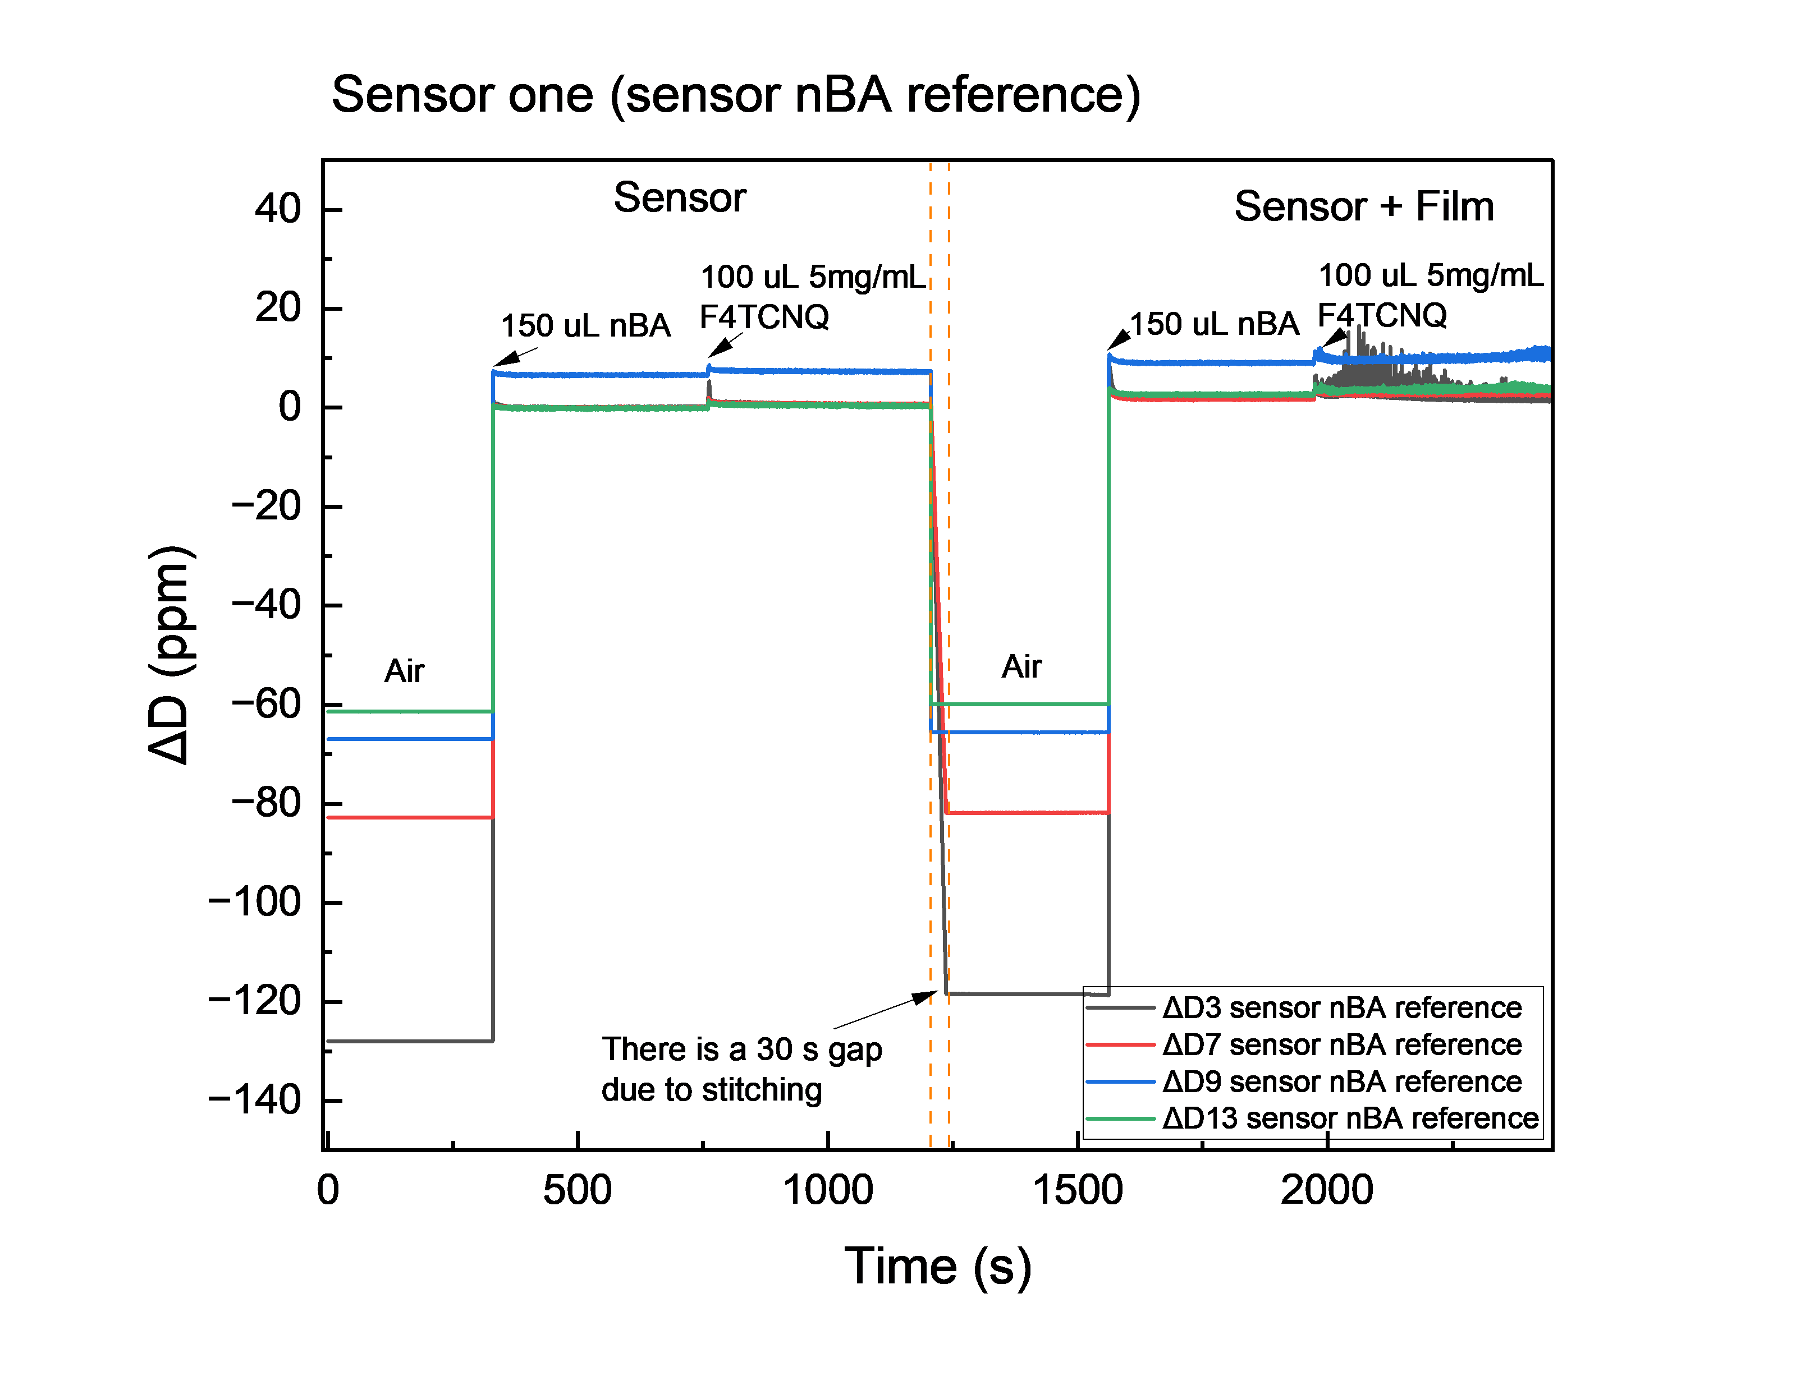
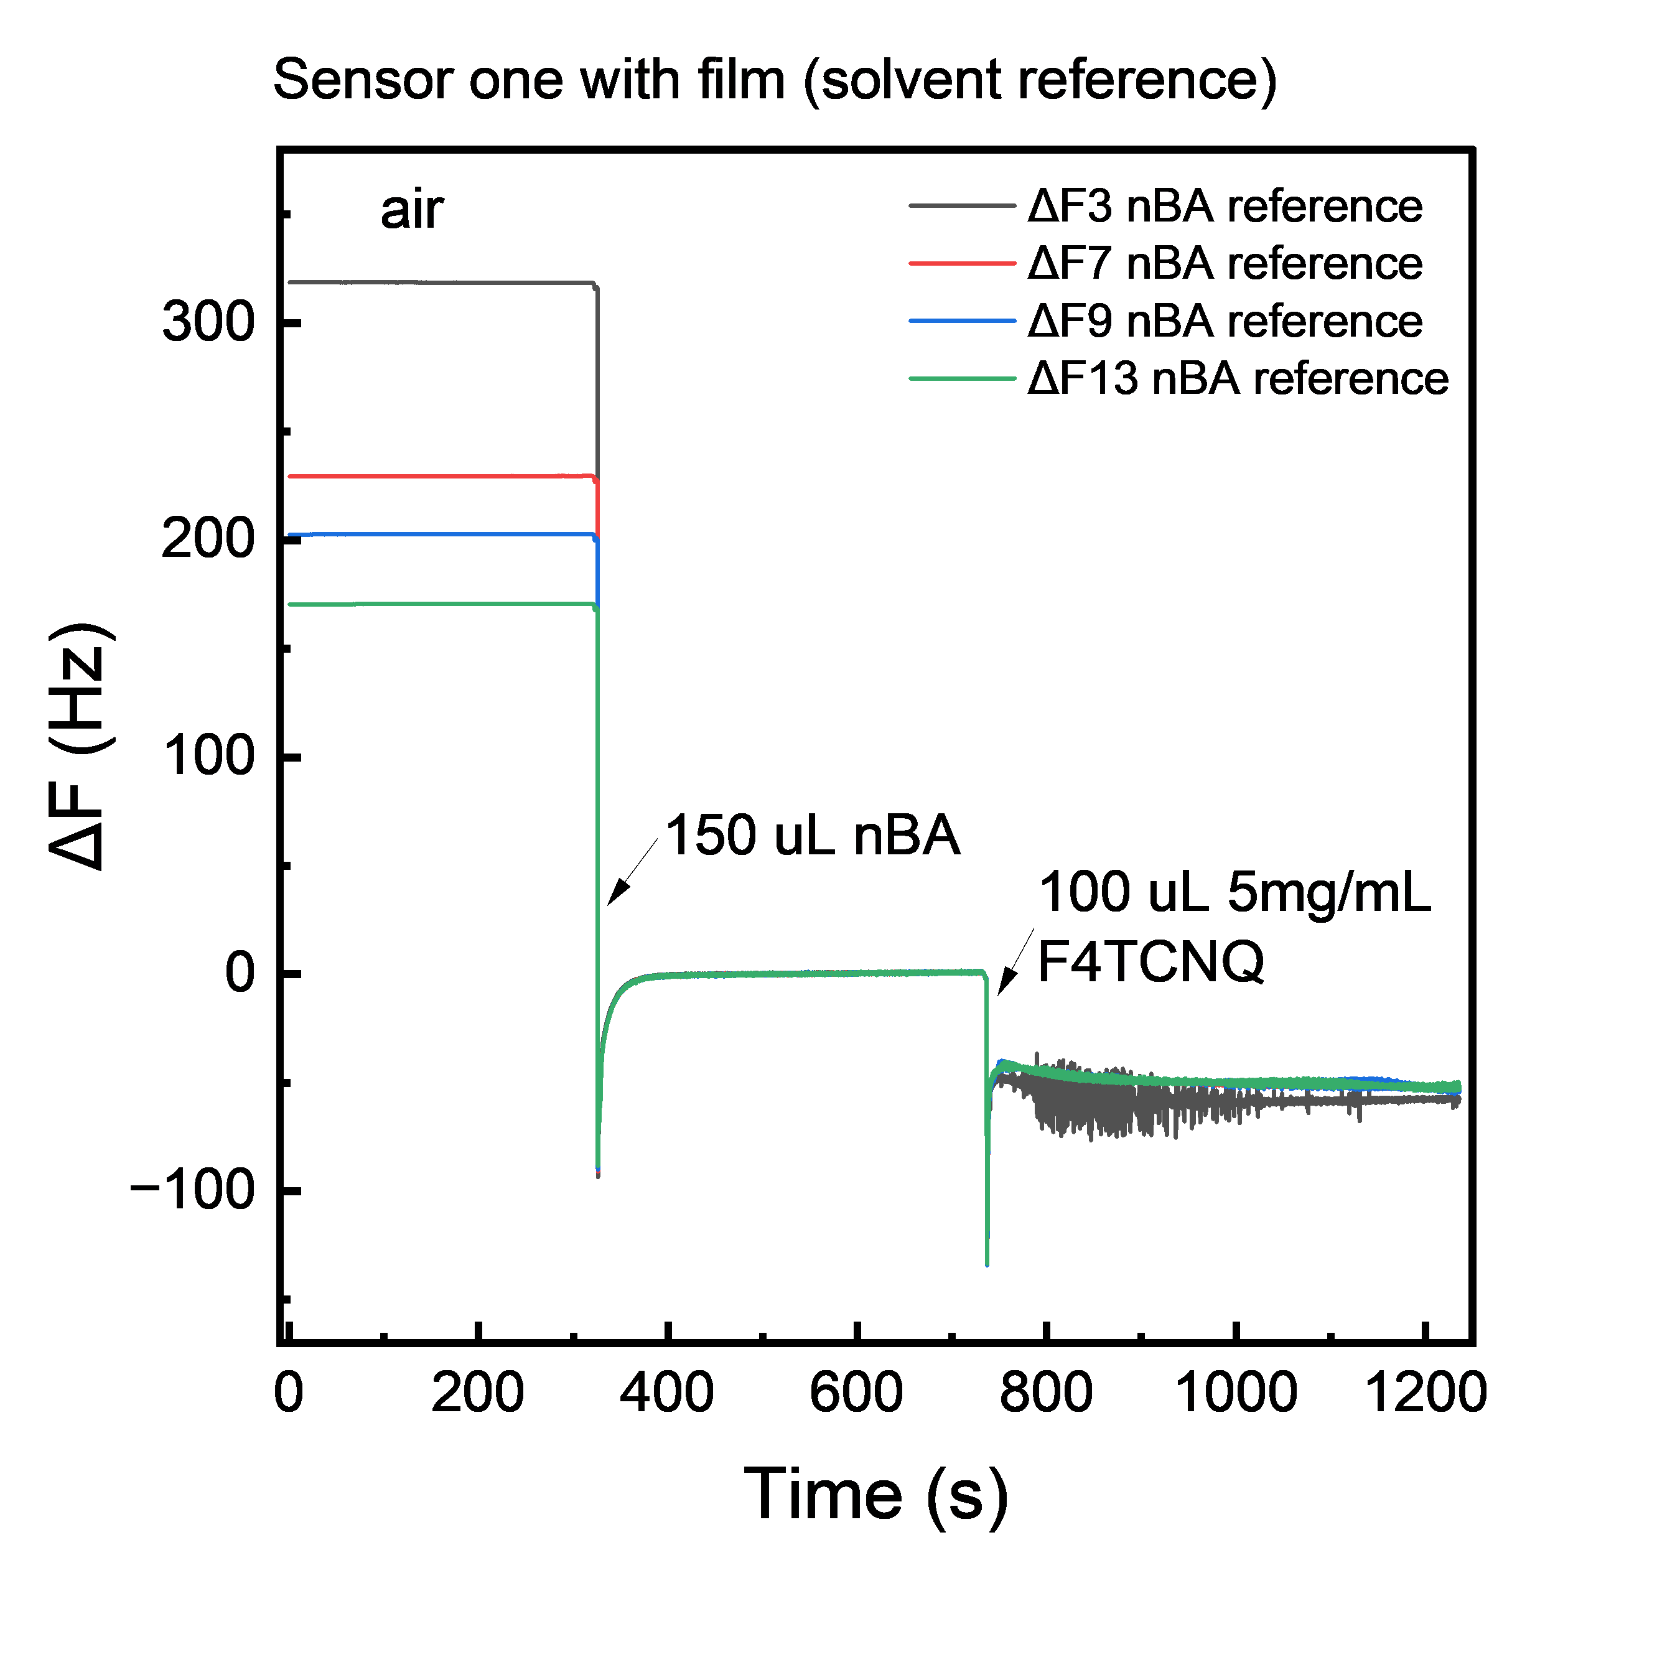
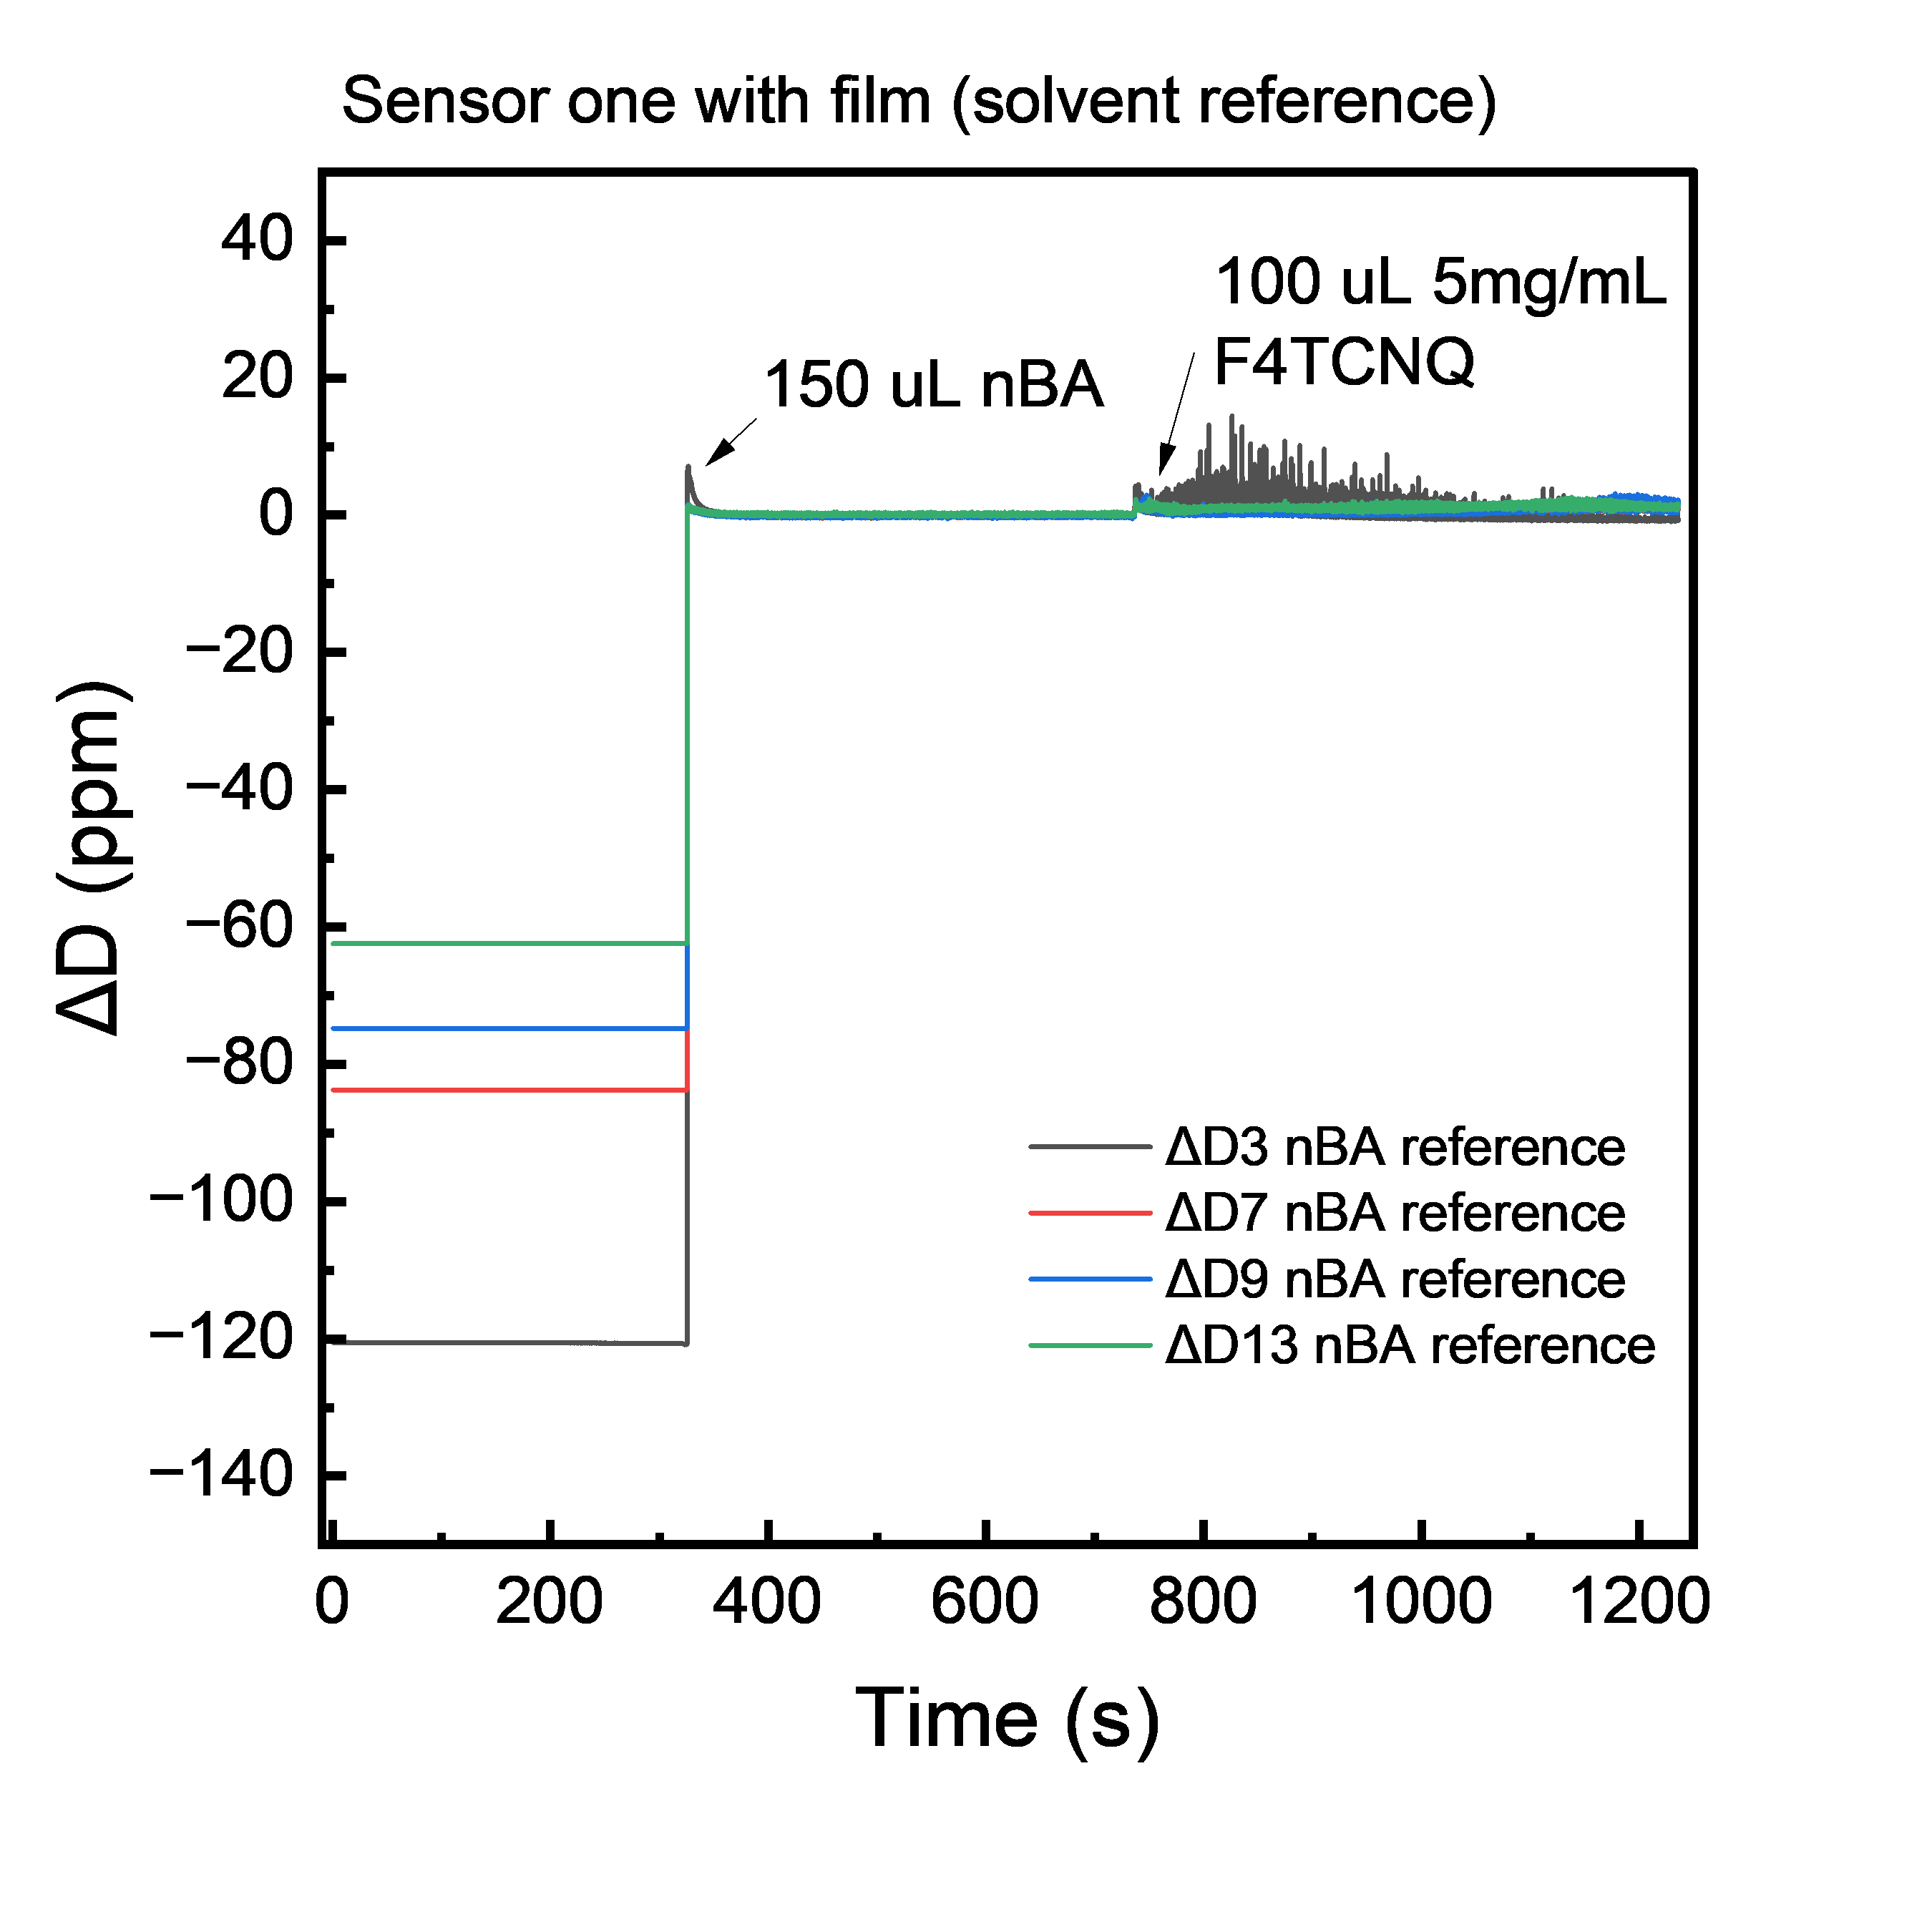
Data example

